Slide 1
Gamify
Presented by Group-1
Members:
Meghesh, PrashantH, Sagar, Sri harsha

Slide 2
Why Gamify?
Imagine being transferred to a new place and missing out on any sporting activity.
Platform where you can collaborate with people who have similar interests and continue to play your favorite sport.
To try a sport that you have never played.
Meet new people as you go.

Slide 3
Features
Login And Registration
User Interface And User Profile
Create Posts And Display Posts Based On User Location
User Preferences
Live Chat
Search Users
Block Users
Create And Manage Groups (Additional Feature)
Advertisements (Additional Feature)

Slide 4
Responsibilities
Feature | Name | Estimated Time (Man-hours) | Actual Time (Man-hours)
Login and Registration | Prashanth, Sagar | 35h | 40h
Homepage | Sagar, Sri Harsha | 75h | 55h
Search | Meghesh, Prashanth | 35h | 40h
Messaging & Live Chat | Sagar, Prashanth | 65h | 60h
Block Users | Meghesh, Sri Harsha | 45h | 35h
Group Management | Prashanth, Sri Harsha | 40h | 35h
User Profile | Sagar, Meghesh | 50h | 45h
Advertisements | Sri Harsha, Meghesh | 25h | 30h
TOTAL |  | 370 h | 340 h

Slide 5

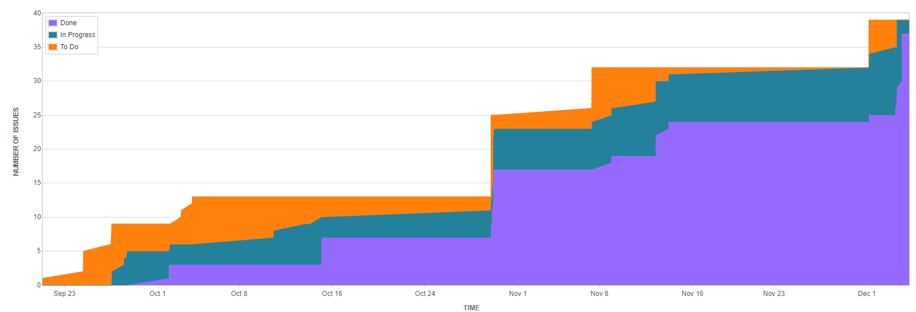
Project Report

Slide 6
Challenges or Issues
Configuring database in IU Server
Implementing Live Chat

Slide 7
Technologies
PHP
AJAX
HTML
CSS
Javascript
MySQL
Backend Language
Frontend / GUI Languages
For Search & Live Chat feature
Database

Slide 8
Github and JIRA Link
Gamify your life at- homes.soic.indiana.edu/prbhat
Git- github.com/prash1987/GamifyWebsite
JIRA- uisapp2.iu.edu/jira-prd/browse/SICESES

Slide 9
Future Enhancements
Integration of Sports related Jobs (Coach, Fitness Trainer, etc.)
Integration of payment gateway system for Paid Events
Paid Advertisements
Addition of Online Games (Similar to Facebook)

Slide 10

Questions?

